Slide 1
Principles of Data Science
Li Niu

Slide 2
Big data (3V)
Big Data are high-volume, high-velocity, and high-variety information assets that require new forms of processing to enable enhanced decision making, insight discovery and process optimization.

Slide 3
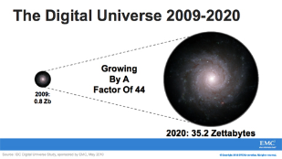

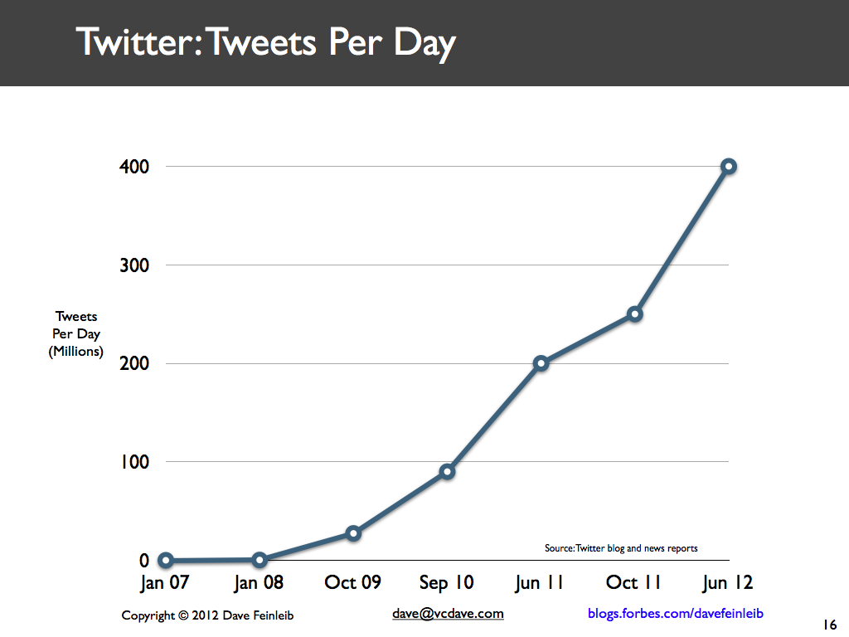
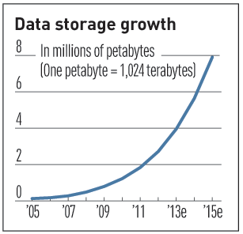
Big data (Volume)
Data Volume
44x increase from 2009 to 2020
From 0.8 zettabytes to 35 zettabytes
Exponential increase in collected/generated data
3

Slide 4
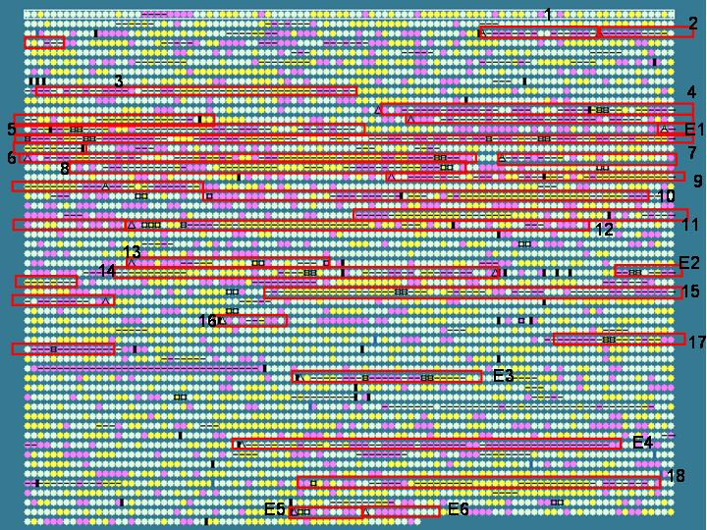
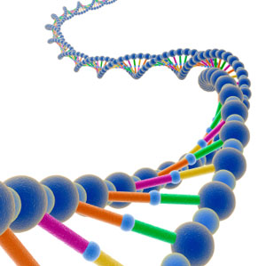
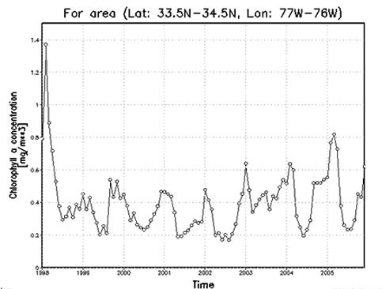
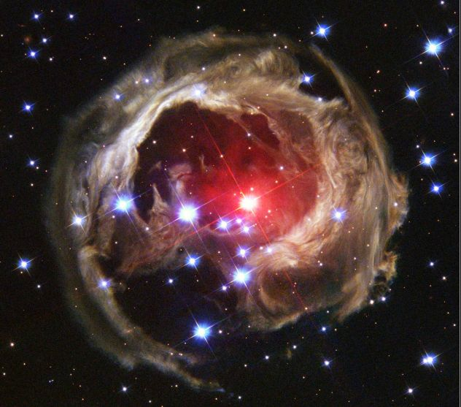
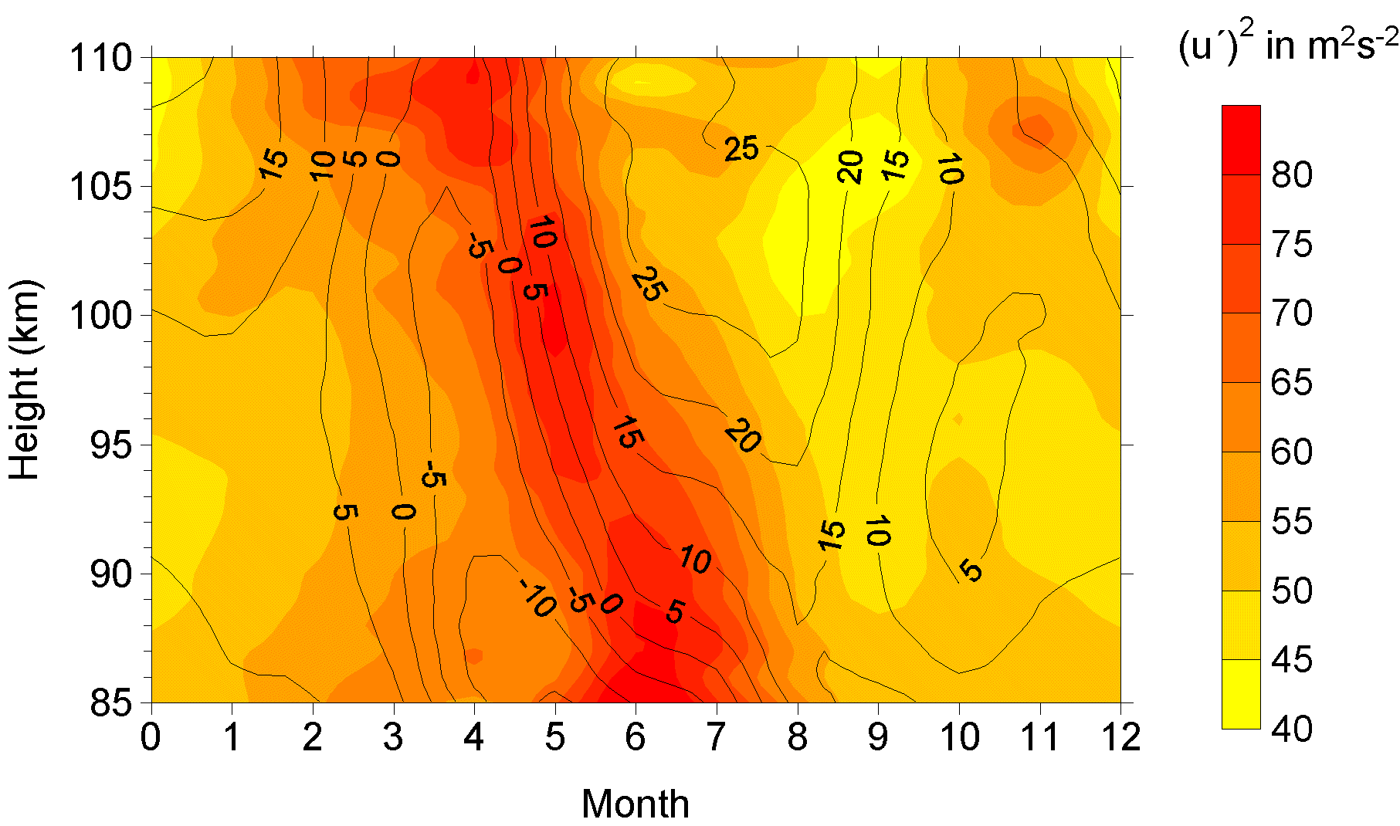

Big data (Variety)
Relational Data (Tables/Transaction/Legacy Data)
Text Data (Web)
Semi-structured Data (XML)
Graph Data
Social Network, Semantic Web (RDF), …
Streaming Data
You can only scan the data once
A single application can be generating/collecting many types of data
Big Public Data (online, weather, finance, etc)

Slide 5
Big data (Velocity)
Data is generated fast and need to be processed fast
Online Data Analytics
Late decisions cause missing opportunities
Examples
E-Promotions: Based on your current location, your purchase history, what you like, send promotions right now for store next to you
Healthcare monitoring: sensors monitoring your activities and body, any abnormal measurements require immediate reaction

Slide 6
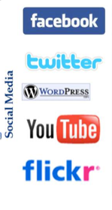
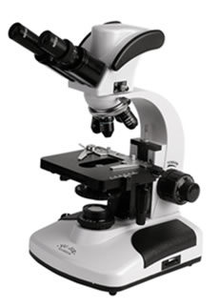

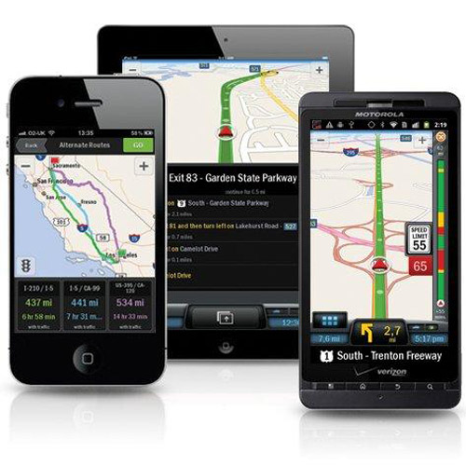
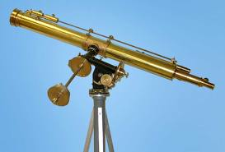
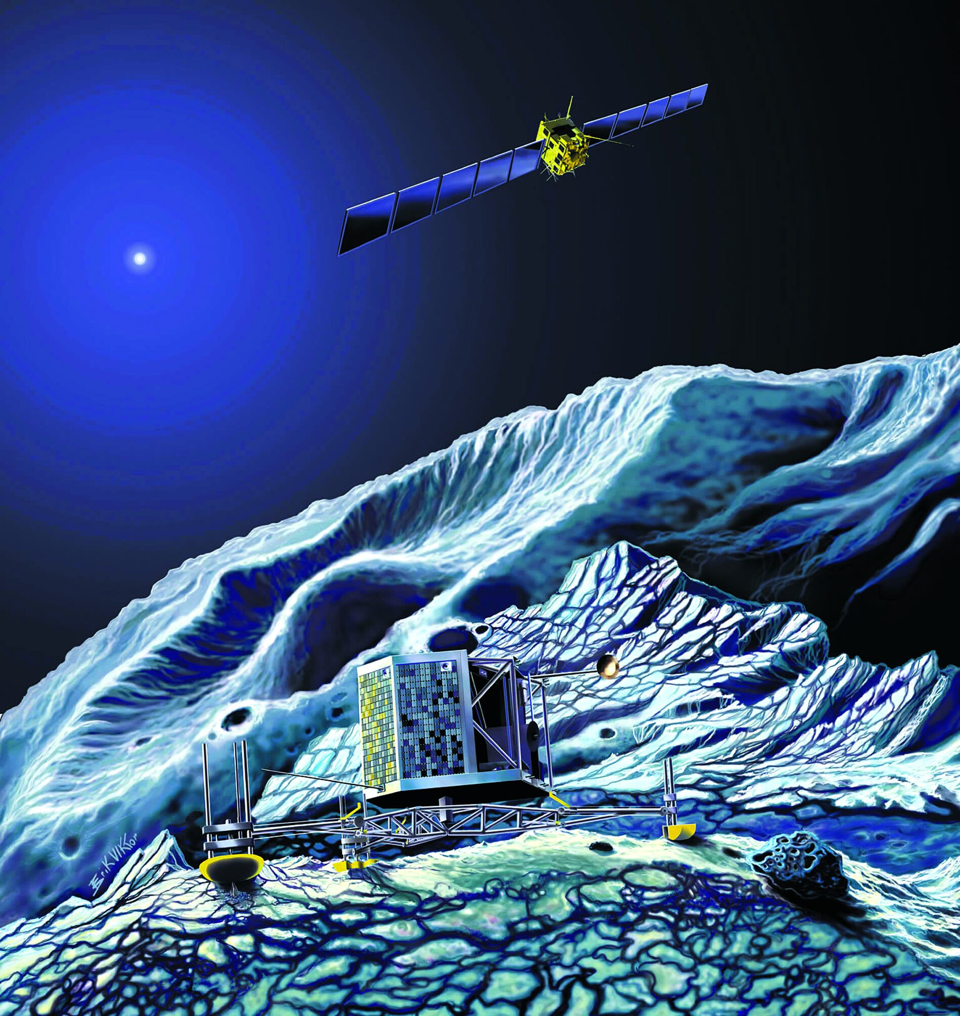
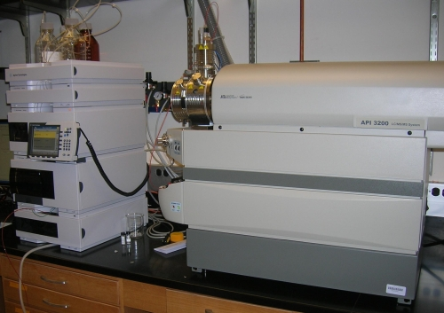
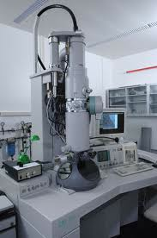
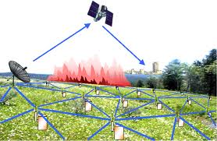
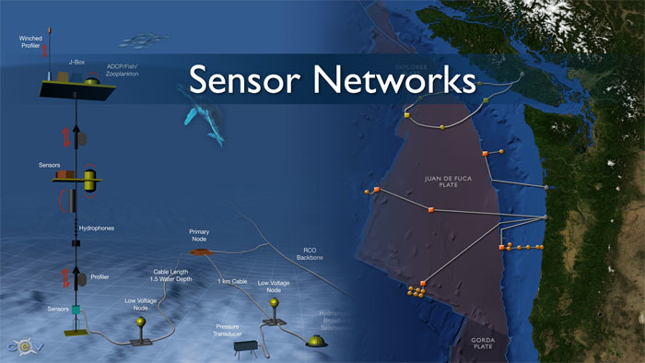
Big data (Velocity)
Mobile devices
(tracking all objects all the time)
Social media and networks
(all of us are generating data)
Scientific instruments
(collecting all sorts of data)
Sensor technology and networks
(measuring all kinds of data)
The progress and innovation is no longer hindered by the ability to collect data
But, by the ability to manage, analyze, summarize, visualize, and discover knowledge from the collected data in a timely manner and in a scalable fashion

Slide 7
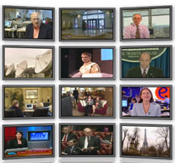

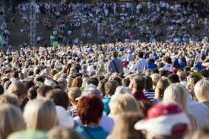

Big data (Velocity)
Previously: Few companies are generating data, all others are consuming data
Now: all of us are generating data, and all of us are consuming data
Capture devices: GPS, Internet, Smartphones, Wearable devices, Sensors
In 2020, there will be 150 billions of recording devices, 20x the Earth population

Slide 8
Techniques involving big data
Massive Parallelism
Huge Data Volumes Storage
Data Distribution
High-Speed Networks
High-Performance Computing
Task and Thread Management
Data Mining and Analytics
Data Retrieval
Machine Learning
Data Visualization

Slide 9
Why is big data hot now?
Low cost storage to store data that was discarded earlier
Powerful multi-core processors
Low latency by high-speed networks
Better understanding of task distribution (MapReduce),
computing architecture (Hadoop)
Advanced analytical techniques (machine learning, deep learning)
Managed Big Data Platforms: Cloud service providers, such as Amazon E2, S3

Slide 10
Research objective
Big Data Analytics:
data mining, machine learning, artificial intelligence
Big Data Computing:
data center support for big data collection and transformation, integration and distributed data management and computing
Big Data Theory:
sampling and statistical theory, big data security and privacy
Big Data Science:
Big Data and Multi-disciplines (Bio, Chemistry, Engineering, Social)

Slide 11
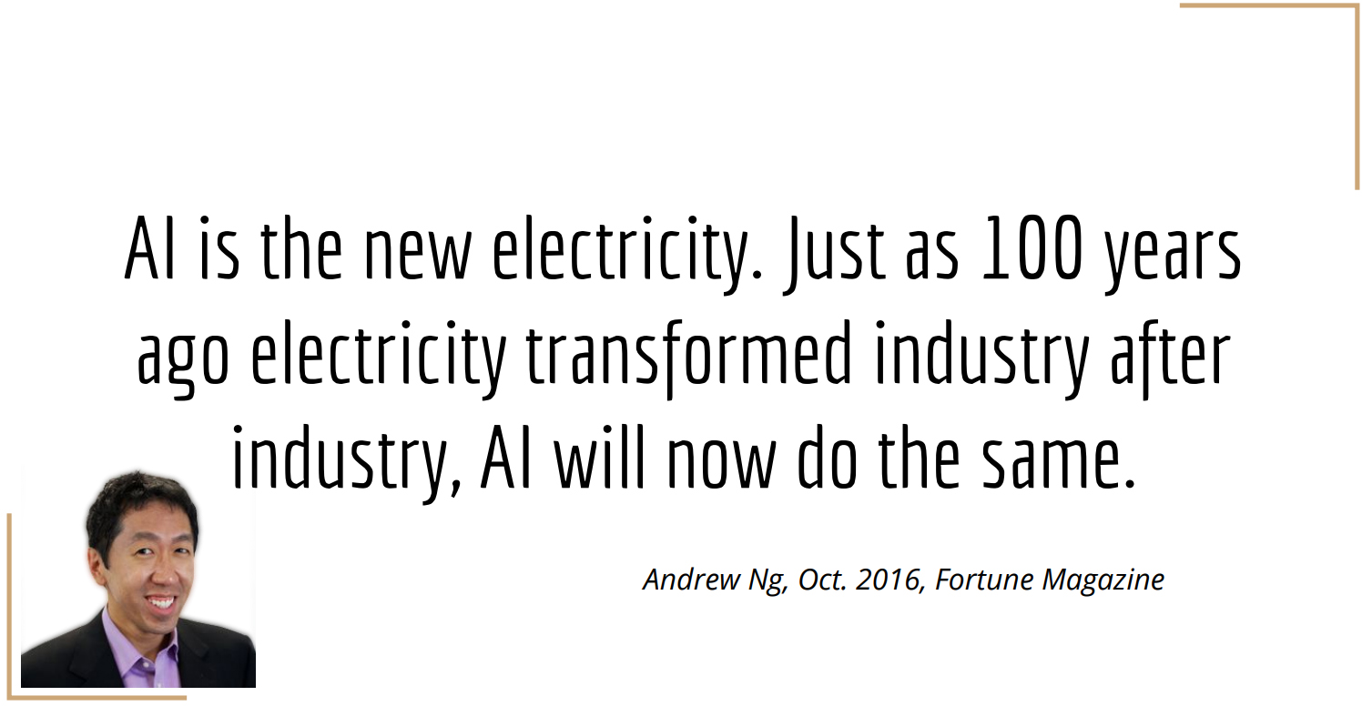
Artificial Intelligence (AI)

Slide 12
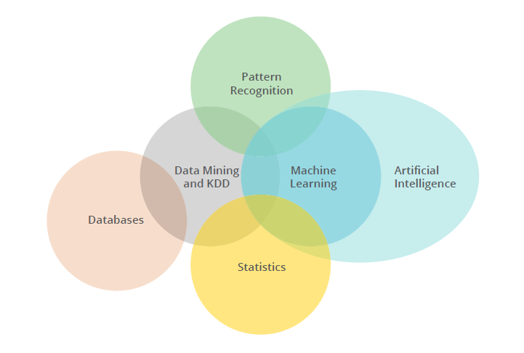
Artificial Intelligence (AI)

Slide 13
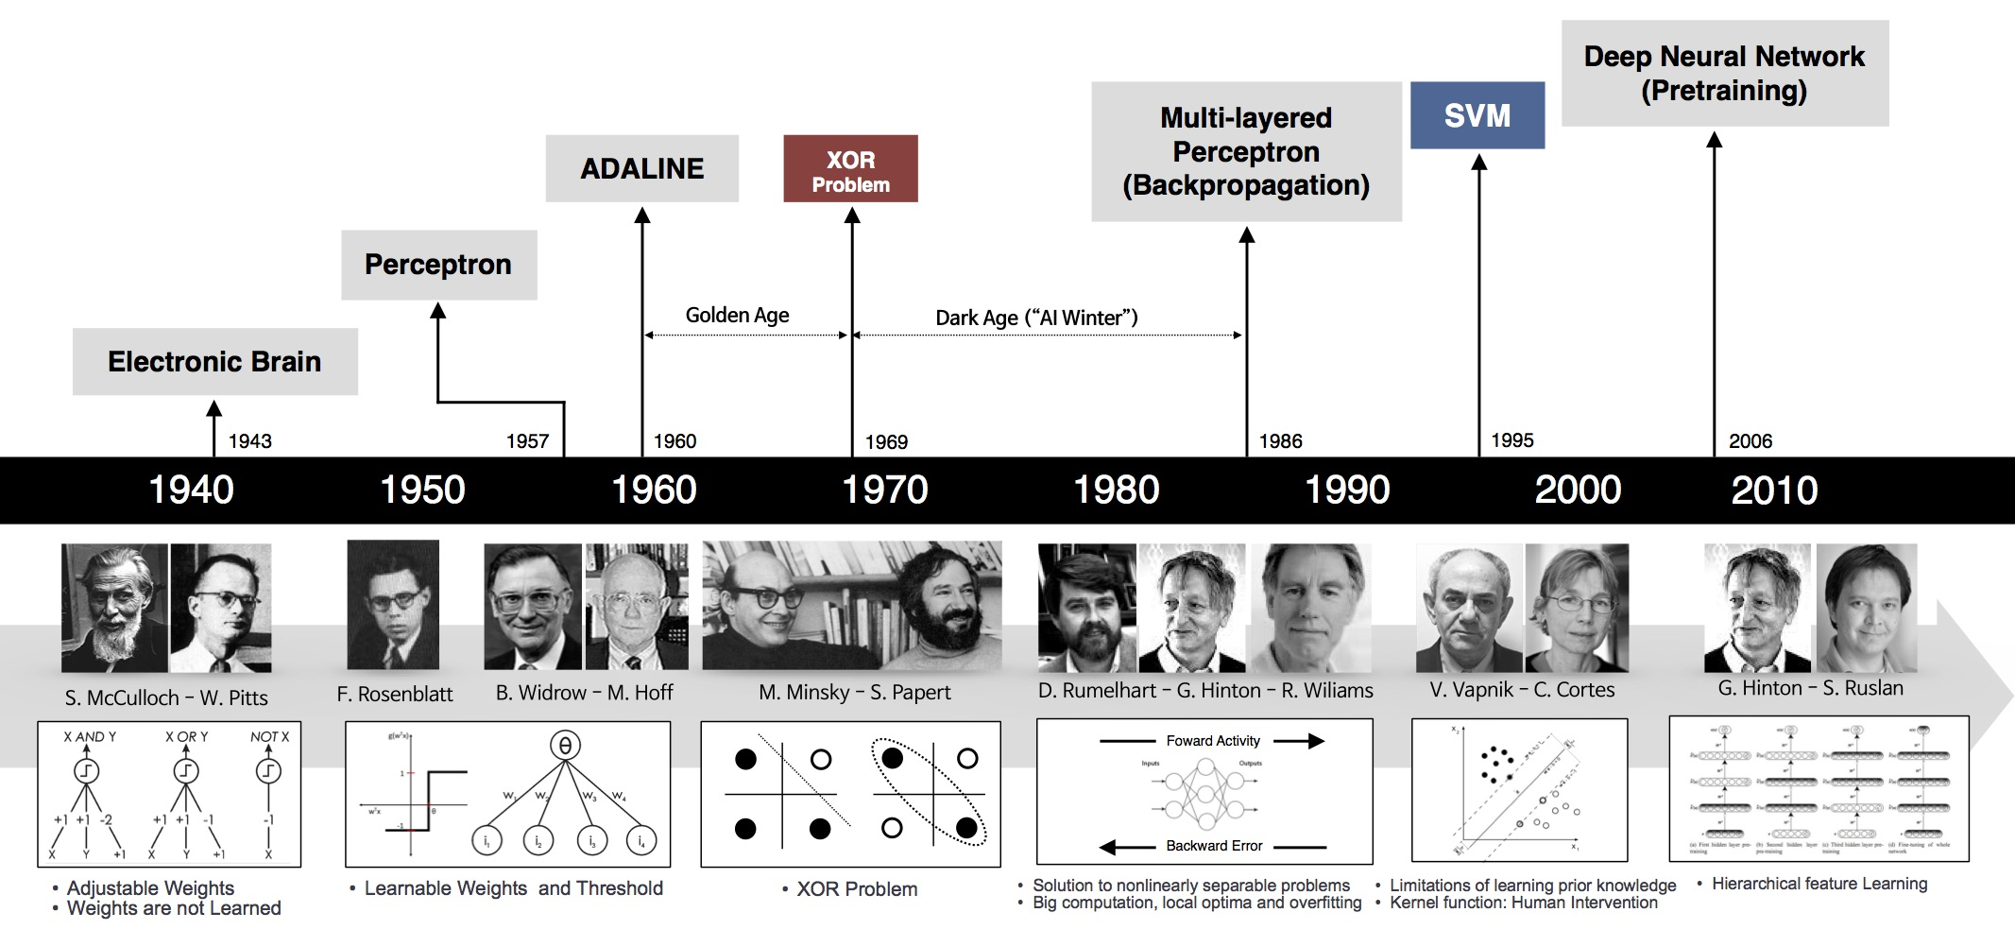
Artificial Intelligence (AI)

Slide 14
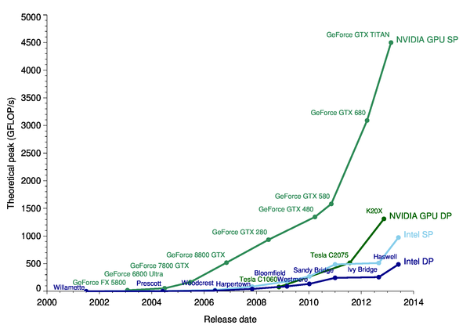
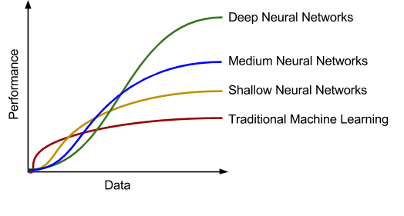
Why is deep learning hot now?
Big Data, GPU, model, and ecosystem
GPU
model

Slide 15
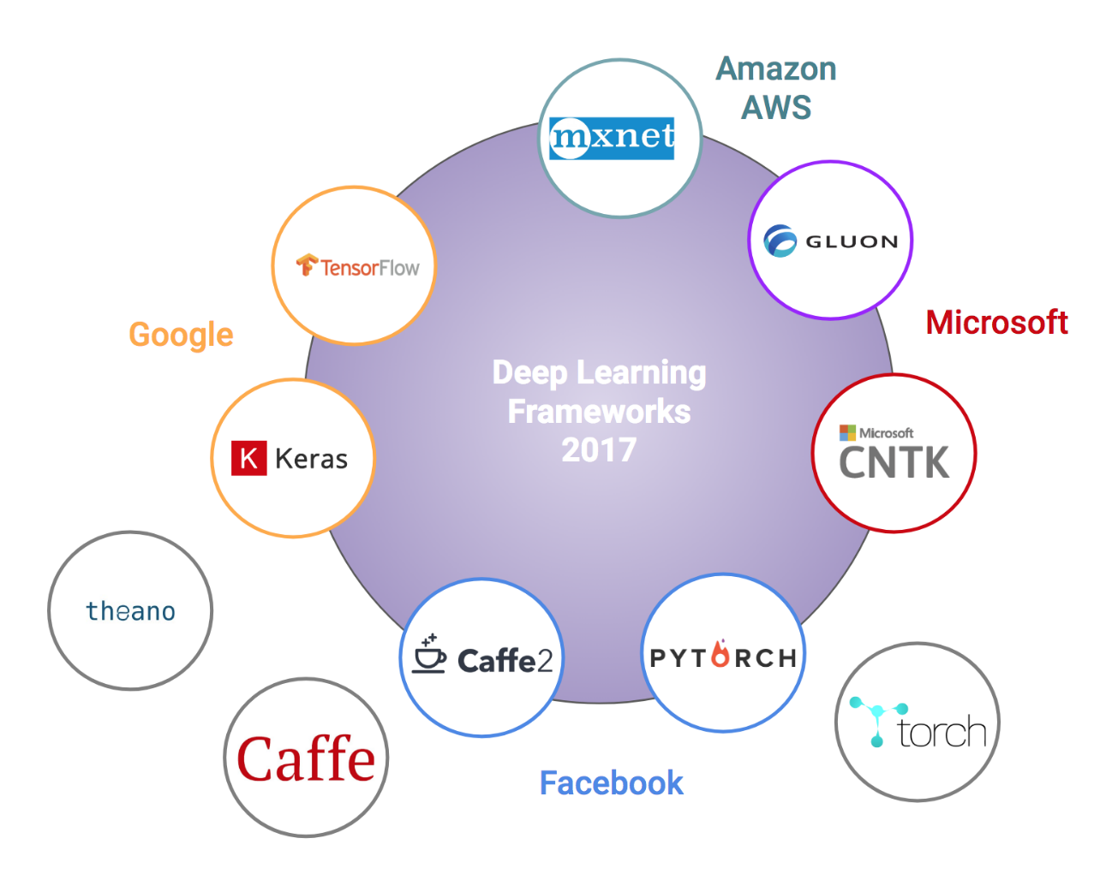
Why is deep learning hot now?
Big Data, GPU, model, and ecosystem

Slide 16
Deep learning
Tasks
Prediction classification, regression problems
Prediction as part of model (end-to-end)
Use model to obtain feature vectors for data, use any classifier for prediction (deep learning feature)
Generation e.g., image, text, video
Reconstruction/completion of partial data (e.g., image inpainting)
Generation of new data by sampling (e.g., unconditional GAN)
Generation of cross-modality data (e.g., image/video captioning)

Slide 17
Deep learning
Tasks
Successful application domains
Prediction classification, regression problems
Prediction as part of model (end-to-end)
Use model to obtain feature vectors for data, use any classifier for prediction (deep learning feature)
Generation e.g., image, text, video
Reconstruction/completion of partial data (e.g., image inpainting)
Generation of new data by sampling (e.g., unconditional GAN)
Generation of cross-modality data (e.g., image/video captioning)
Image: object recognition, optical character recognition
Audio: speech recognition, music retrieval
Text: parsing, sentiment analysis, machine translation

Slide 18
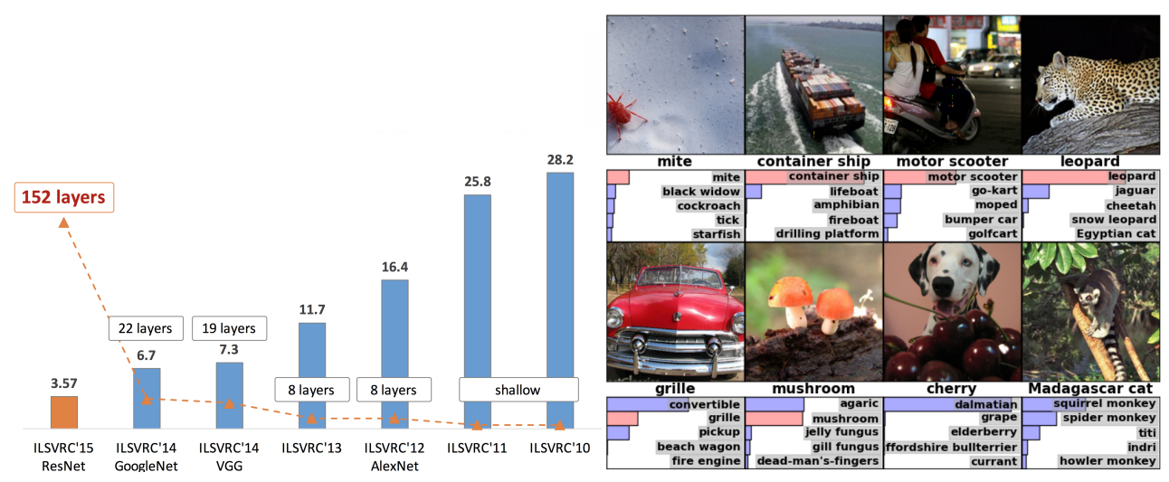
Success of deep learning
Image recognition
AlexNet in 2012
Deeper architectures, more connections: Inception, ResNet, DenseNet, ResNeXt
2.4% Top-5, 14.6% Top-1

Slide 19
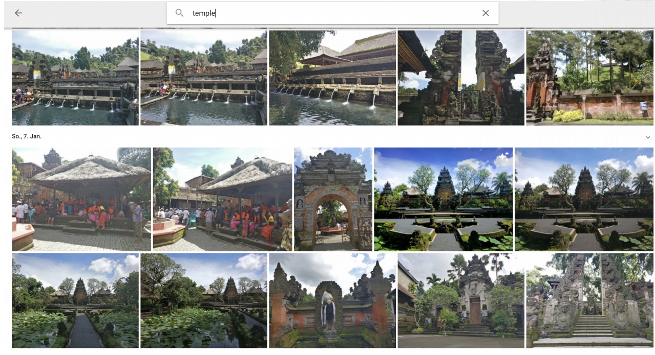
Success of deep learning
Image retrieval
: tag-based image retrieval, content-based image retrieval

Slide 20
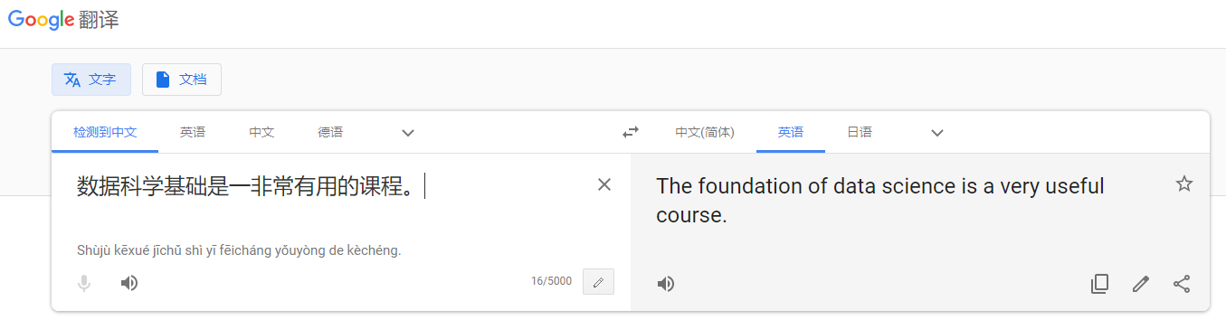
Success of deep learning
Machine translation
State-of-the-art: Neural machine translation
Transformer, based on self-attention; RNMT+
Phrase-based still better on low-resource languages
But: Only superficial understanding; not close to a ‘real’ understanding of language yet

Slide 21
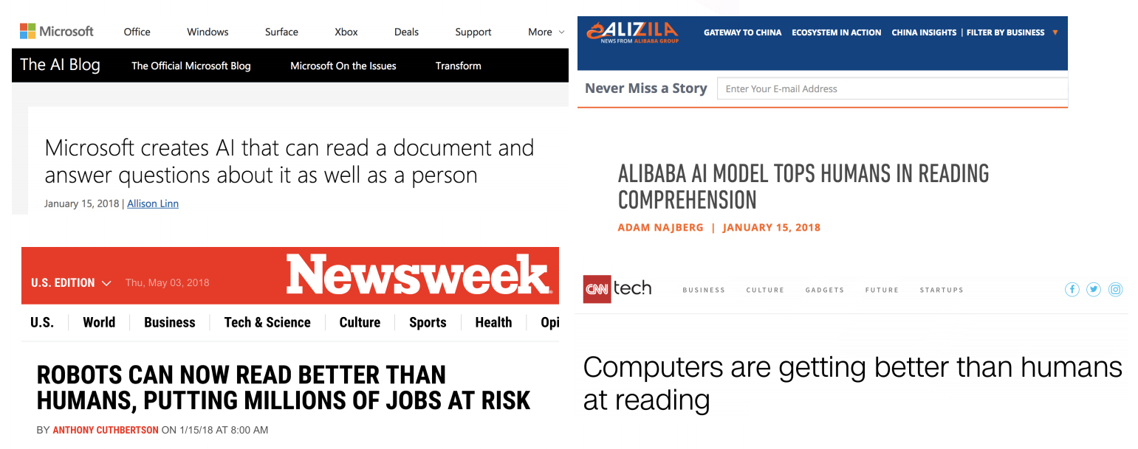
Success of deep learning
Reading comprehension

Slide 22
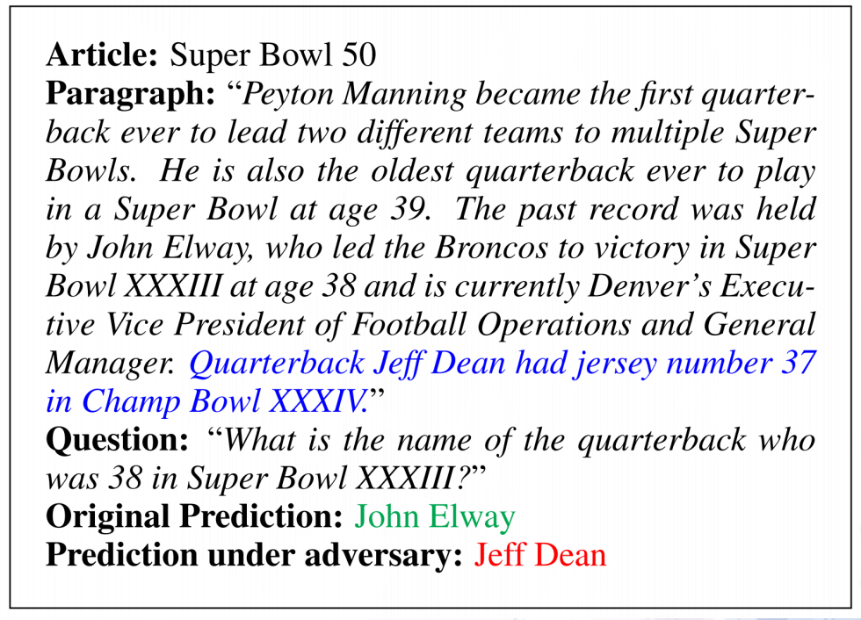
Deep learning can be easily fooled
Models exploit superficial pattern-matching

Slide 23
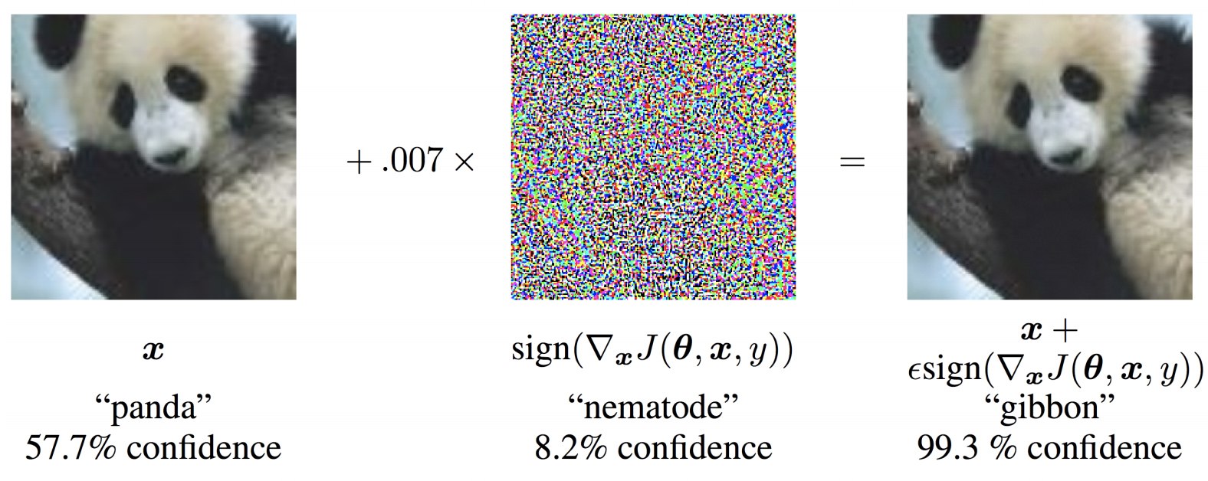
Deep learning can be easily fooled
Adversarial examples: intentionally designed examples to fool the model

Slide 24
Thanks!

